Slide 1

Spent Nuclear Fuel in Dry Storage Conditions – Current Trends in Fuel Performance Modeling
Piotr Konsrski, Cedric Cozzo, Grigori Khvostov, Hakim Ferroukhi
NE 533 (Paper Project 2)
Rubyea Yeasmin
Graduate Student
Department of Nuclear Engineering
North Carolina State University

Slide 2
Outline
Introduction
Dry Storage Conditions
Important Phenomena Discussed in Prior Works
Experimental Supports
Conclusion

Slide 3
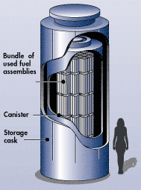
Introduction
Once the nuclear fuel rod spends its full cycle in the reactor, they are first temporarily stored in a Spent Fuel Pool.
After several years, when the fuels are cool enough, they are moved into a dry storage cask.
Currently, dry storage is permitted for limited time (20-50 years), which is expected to be extended to 100+ years.
Extensive research has been done to analyze and model the fuel behavior during dry storage period.
This paper presents previous works related to such exploration.
Dry storage of SNF. Image Source: NRC.gov

Slide 4
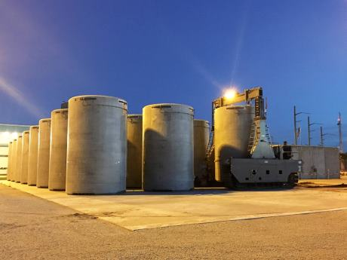
Introduction
Highly radioactive and hot Spent Nuclear Fuel (SNF) need to be safely stored.
Wet storage options can be storing them in a pool, which is inefficient.
Dry storage is more advantageous due to: → Mature technology → Ready-to-implement → Passive Safety Principles → Scalability of storage facility → Long term cost efficiency.

Slide 5
Dry Storage Conditions
Temperature: → Spent Fuels are first dried using vacuum or forced helium drying.
Temperature can be maximum at the end of drying.
US Nuclear Regulatory Commission (NRC) mandates that cladding peak temperature of a dry stored fuel must not exceed 400℃.
This maximum temperature regulation varies among different nations: Japan 200-300℃.
Rod Internal Pressure and Cladding Stress: → US limit: 90Mpa at 400℃.
→ Japan: 70-100MPa, depending on cladding type.

Slide 6
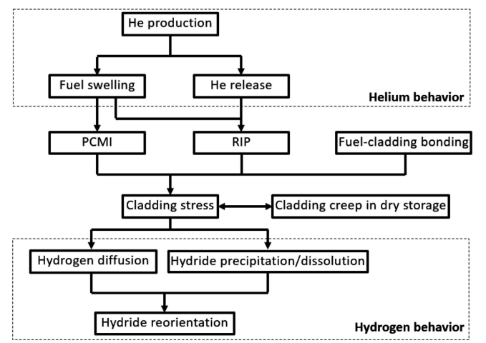
Important Phenomena to Study
Many prior studies have examined different phenomena that effects the dry storage condition and rod integrity.
Two most widely explored phenomena are Helium and Hydrogen behavior that cause PCMI and RIP in the fuel.
Such behavior increases cladding stress and can negatively impact the integrity

Slide 7
Important Phenomena: He Production and Behavior
During irradiation, fission gas is released. The α decay produces helium gas, which has significant impact.
The released helium gas can cause swelling when retained in the fuel matrix.
Such phenomena can cause Pallet Cladding Mechanical Interaction (PCMI) or Rod Internal Pressure (RIP).
Many prior works, including Luzzi et al.[30], Cognini et al. [31] analyzed such behavior extensively.

Slide 8
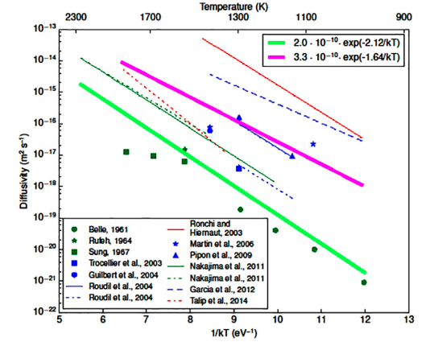
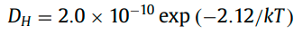
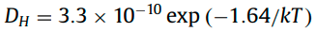
Helium Diffusivity
Helium Diffusion Coefficient can indicate the helium diffusivity.
Luzzi et al. [30] analyzed the experimental results on He diffusivity.
Two groups:
(1) (2)
According to their results, experimental data used for fitting is scattered and thus empirical correlations are of high uncertainty.

Slide 9
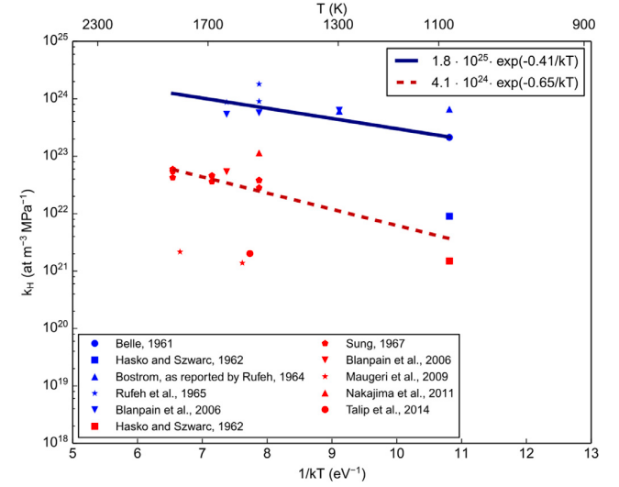
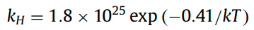
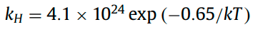
Helium Solubility
Cognini et al. [31] analyzed the experimental data for He solubility using infusion technique.

Slide 10
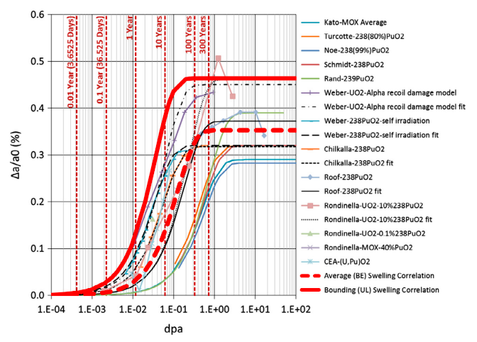
Fuel Pellet Swelling
Fuel pellet swelling can occur due to He gas release as He particle can knock on atoms in UO2 lattice.
This phenomenon is reviewed in the work done by Raynaud and Einziger [28]

Slide 11
Cladding Stress
Increase in RIP (by He release) and PCMI (fuel swelling) increases stress and can impacts cladding integrity.
The paper presents several studies done at NRC and KAERI.
Several fuel performance simulations have been done for study stress during dry storage by Raynaud and Einziger [28,39].
Simulation is performed using FRAPCON-3.5 with irradiation up to 65GWd/tU, for 5 wet storage years and 295 dry storage years.

Slide 12
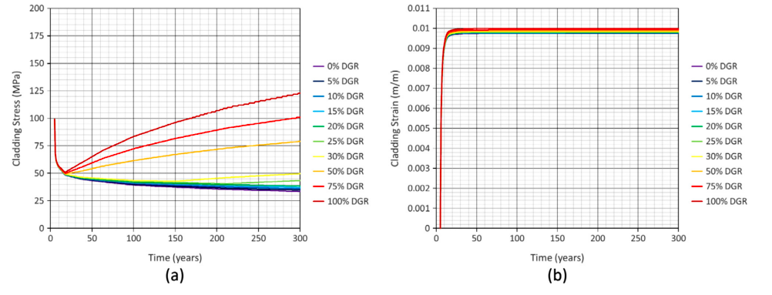
Cladding stress and strain

Slide 13
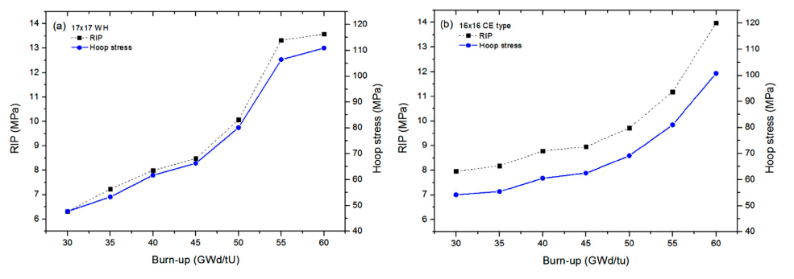
Rod Internal Pressure (RIP)

Slide 14
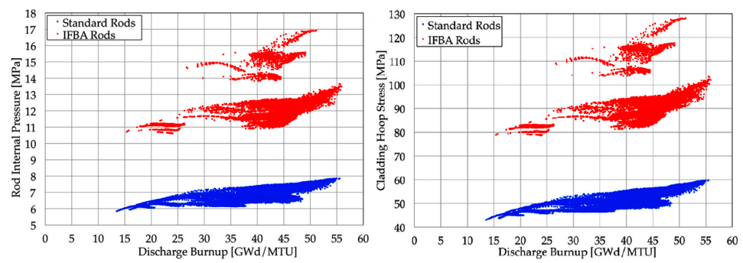
Rod Internal Pressure (RIP)

Slide 15
Important Phenomena: Hydrogen Production and Behavior
Fuel rods encounter waterside corrosion due to hydrogen absorption during reactor operation.
Absorbed hydrogen later diffuses and interacts with the fuel.
It is important to analyze Hydrogen interaction while storing the fuel.
Hydrogen can be either dissolved in the solid solution or precipitate as radial or tangential hydrides.

Slide 16
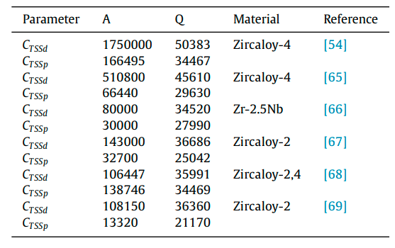
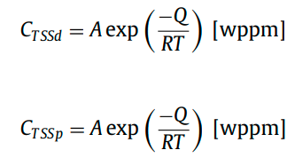
Important Phenomena: Hydrogen Production and Behavior
If the hydrogen concentration is below the Terminal Solid Solubility for Dissolution (TSSd), hydrogen will be dissolved in the solid solution phase.
If the concentration is higher than Terminal Solid Solubility for precipitation (TSSp), it precipitates as hydrides.
TSSd and TSSp is given by-

Slide 17
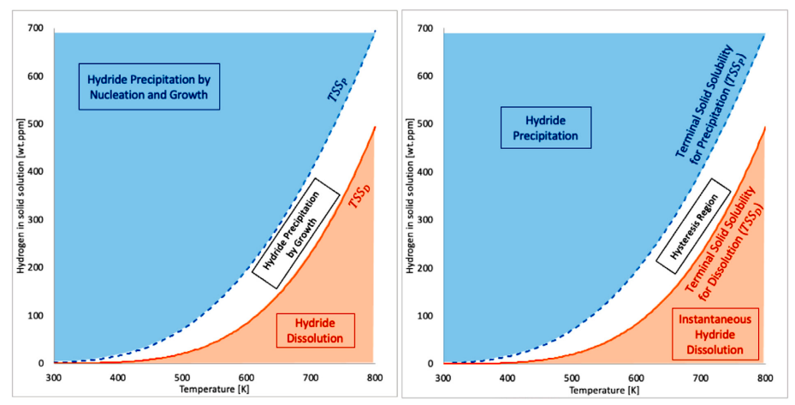
Laroix et al. [73] has developed a model for hydrogen dissolution and precipitation called the Hydride Nucleation-Growth-Dissolution (HNGD).
Passelaigue et al.[75] has compared this HNGD model with the model available in BISON.

Slide 18
Delayed Hydride Cracking (DHC)
DHC starts when the stress intensity exceeds a threshold named Stress Intensity Factor, K_{IH}
DHC is a major degradation factor in both BWR and PWR fuel rods.
Kim et al. [44] have reviewed the prior literature regarding DHC and the related parameters.

Slide 19
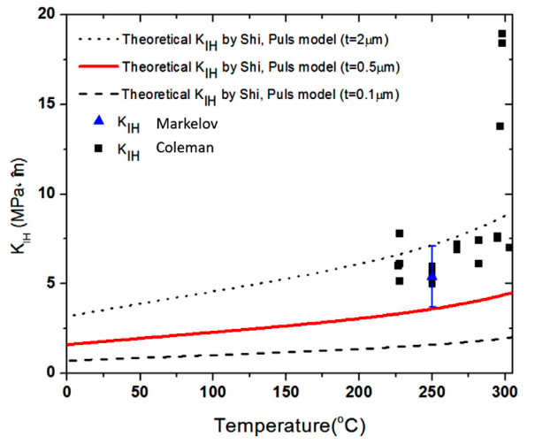
Delayed Hydride Cracking (DHC)
Kim et al. [44] have compared the studies done on Stress Intensity Factor in the prior literature, as shown in the figure.

Slide 20
Experimental Supports to Dry Storage Models
Fatigue during transportation:
During transportation, cladding integrity can be affected due to vibration.
Many experimental works has been done to obtain good understanding of the mechanical behavior of the rod and its fatigue under vibration.
Cyclic Integrated Reversible-bending Fatigue Tester (CIRFT), developed by ORNL, is such an experiment that explores mechanical fatigue of SNF.

Slide 21
Experimental Supports to Dry Storage Models
Fatigue during transportation:
Conclusions of Cyclic Integrated Reversible-bending Fatigue Tester (CIRFT) includes: # Cladding fatigue mainly occur near the pellet-pellet interface. # Thick oxide layer or high hydrogen concentration can reduce fatigue time to
failure. # Pellet-cladding and pellet-pellet bonding efficiency can affect SNF fatigue time to
failure. # Stress concentrations and residual stresses in SNF strongly depend on in-reactor
stress history.

Slide 22
Effect of slow cooling:
Generally, the cooling rate of spent nuclear fuels is incredibly low, around 3℃/year.
It is important to understand how such slow cooling impacts the cladding integrity and fatigue.
The effect of such slow cooling is currently being experimented by KAERI.

Slide 23
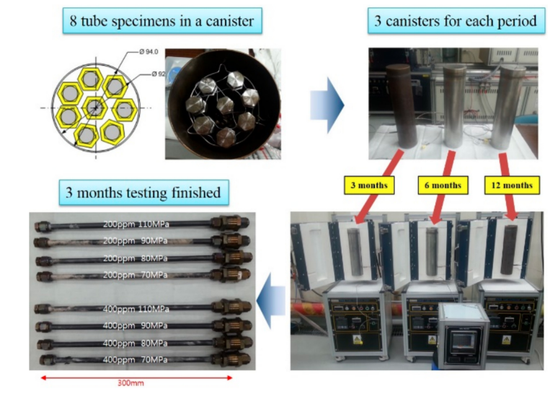
KAERI experiment:

Slide 24
Conclusion
Storage of spent nuclear fuel is very important due to difficulties regarding disposing the fuel and environmental factor.
Dry storage is one of the most optimal, cost effective, and scalable method of storing SNF.
There has been numerous studies to understand the phenomena and fuel behaviors regarding dry storage.
This paper summarized many prior studies and compares against many computational, theoretical and experimental model.

Slide 25


